Slide 1
MPPT in WECS using ML.
(Maximum Power Point Tracking in Wind Energy Conversion Systems using Machine Learning )
By,
Siddarth Sreeni 2014A3PS250G
Sahitya Tahiliani 2014A8PS775G

Slide 2
What is WECS ?
Wind turbines, Wind mills etc.
Apparatus for converting the kinetic energy available in the wind to mechanical energy that can be used to power up machinery
The major components of a typical wind energy conversion system include a wind turbine, a generator, interconnection apparatus, and control systems.

Slide 3
Solar Energy Conversion Systems
Most used renewable energy system
Eg: Germany, Italy

Slide 4
Why WECS?
Wind energy accounts for less than 2% of the country’s electricity.
The Indian Wind Energy Association estimates that electricity generation capacity could reach 65,000 Megawatts.

Slide 5
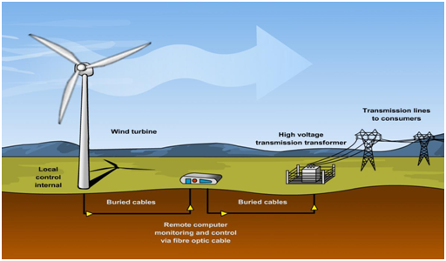
A typical wind farm and its components

Slide 6
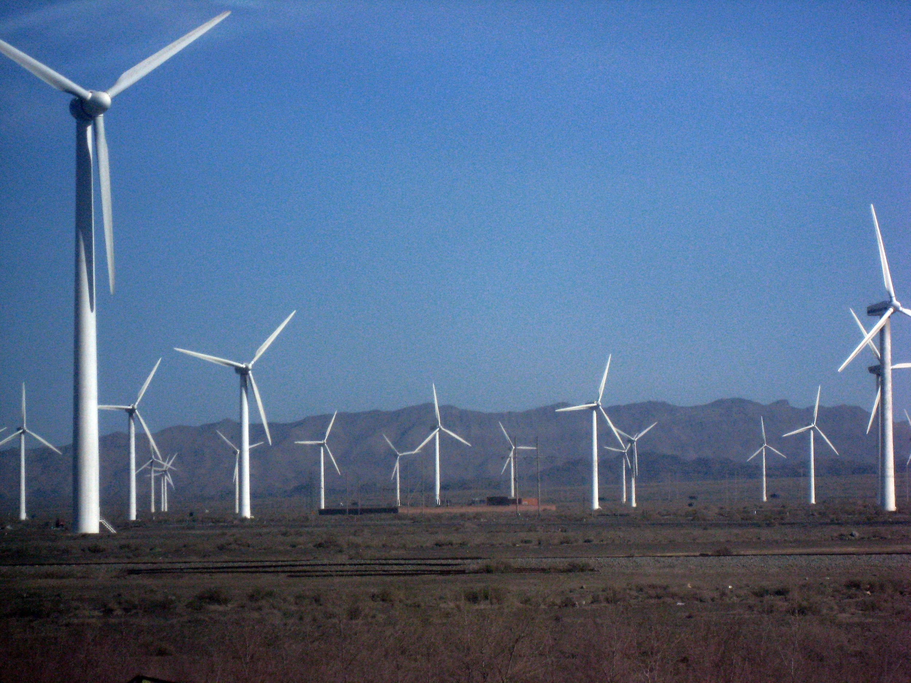
To start with WECS, We need efficient Charger Controllers
Use of MPPT
Promising results and ease of implementation

Slide 7
MPPT
To get maximum Power
Long term savings
A “smart” Controller
Optimization
Maximum Power Point Tracking in WECS
In this project, We talk about a smart controller we propose using AI

Slide 8
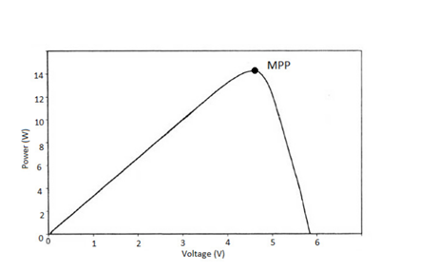
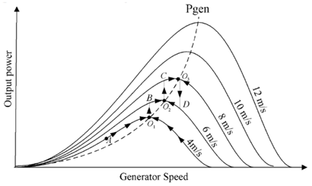
P-V characteristics curve of a Wind-Turbine (depicting Maximum Power-Point)
Output power vs. generator speed curve for a wind turbine

Slide 9
COMMON ALGORITHMS USED FOR MPPT:
Perturb and Observe
Method of Incremental Conductance
Current Sweep
Constant Voltage
Fuzzy Logic Control
Neural Network
Perturb and Observe
Method of Incremental Conductance
Current Sweep
Constant Voltage
Fuzzy Logic Control
Neural Network

Slide 10
PERTURB AND OBSERVE

Slide 11
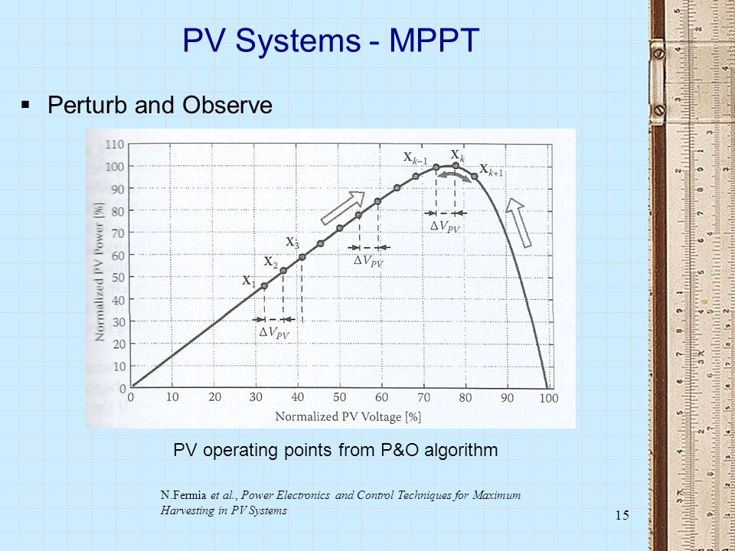

Slide 12
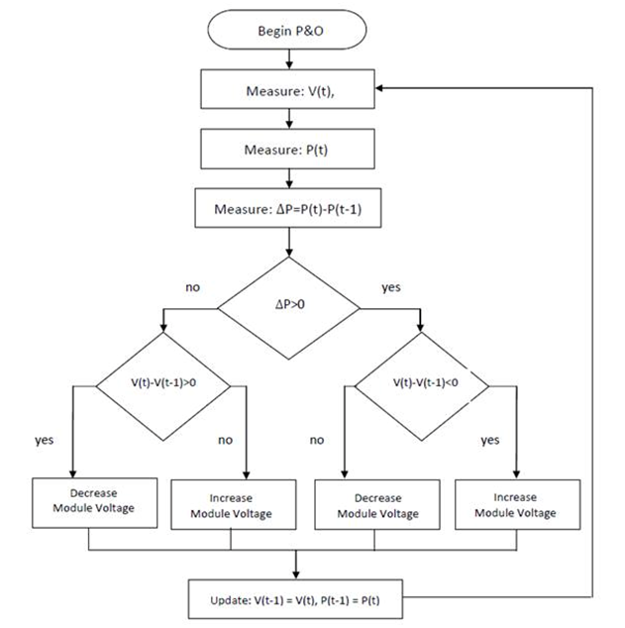
Flowchart depicting Perturb and Observe Algorithm

Slide 13
INCREMENTAL CONDUCTANCE

Slide 14
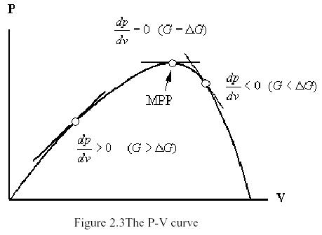
Incremental Conductance

Slide 15
Current Sweep

Slide 16
Uses a sweep waveform for the current such that the I–V characteristic of the generator is obtained and updated at fixed time intervals
The current sweep takes about 50 ms, implying some loss of available power
Only feasible if the power consumption of the tracking unit is lower than the increase in power that it can bring to the entire system

Slide 17
Constant/Fractional Voltage

Slide 18
Output voltage is regulated based on a constant ratio to the measured open circuit voltage.
the power delivered to the load is momentarily interrupted and the open-circuit voltage with zero current is measured
The operating point of the generator is thus kept near the MPP by regulating the voltage and matching it to the fixed reference voltage V_{ref}=kV_{OC}

Slide 19
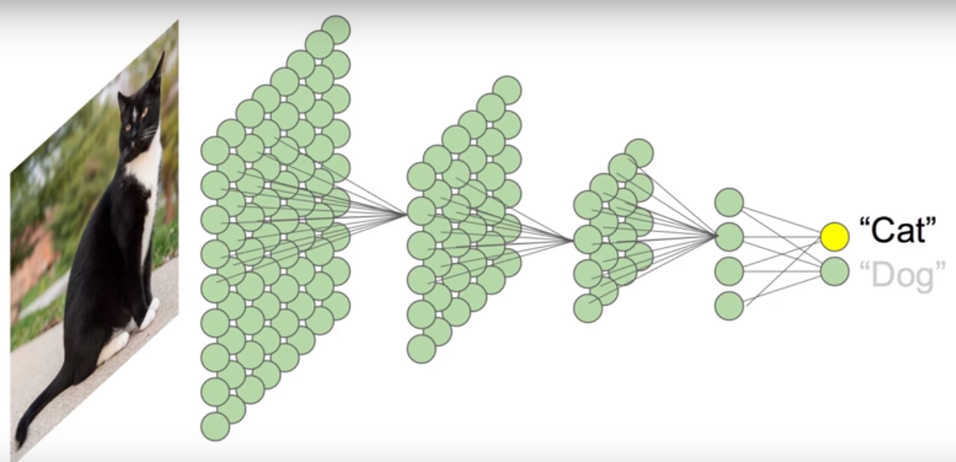
Neural Networks
TRAINING DATA BASED:

Slide 20
FUZZY LOGIC Controller:
Works on fuzzy sets.
Categorises data into sets of different performance.
Keeps on narrowing the sets based on similarities to different sets using training rules.
Detects final values by reaching the top level sets.
Works on training data for fuzzy sets.

Slide 21
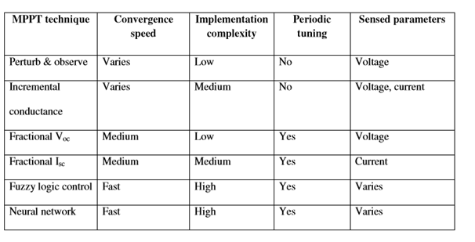
Comparing different MPPT techniques on various parameters

Slide 22
PROPOSED DESIGN

Slide 23
IMPLEMENTED ALGORITHM:
We chose Perturb and Observe Method for implementation in Machine learning since it is :
widely used method
easy and feasible to implement
Medium Complexity
Automatic Tuning
gives very high accuracy

Slide 24
MACHINE LEARNING:
Machine learning is a type of artificial intelligence (AI) that provides computers with the ability to learn without being manually programmed.
Machine learning focuses on the development of computer programs that can teach themselves to grow and change when exposed to new data.
simply using statistical analysis and predictive analytics to identify patterns in the data generated.

Slide 25
LINEAR REGRESSION MODEL :
y = B₀ + B₁*X¹ + B₂*X² + … + B_{n}*X^{n}
The linear equation assigns one scale factor to each input value or column, called a coefficient and represented by the capital Greek letter Beta (B). One additional coefficient is also added, giving the line an additional degree of freedom (e.g. moving up and down on a two-dimensional plot) and is often called the intercept or the bias coefficient.

Slide 26
Terminology Used:
E_{b}-Armature Voltage
R_{a}-Armature Resistance
I_{L}-Load Current
R_{L}-Load Resistance
I_{f}-Field Current
V-Voltage Across Load
K_{f-}Field Constant
K_{a}-Armature Constant
w-rotor speed (RPM)

Slide 27
EQUATIONS USED:
(FROM A SEPARATELY EXCITED DC GENERATOR CONNECTED TO THE WIND TURBINE)
V=E_{b}xR_{L}/(R_{a}+R_{L})
I_{L}= E_{b}/(R_{a}+R_{L})
E_{b}=(K_{f})x(K_{a})x(I_{f})x(w)
Hence, the formulated equation for Power generated is:
P(Power)= [(K_{f})x(K_{a})x(I_{f})x(w)/(R_{a}+R_{L})]²x(R_{L}) {As,P=(V)x(I_{L})}

Slide 28
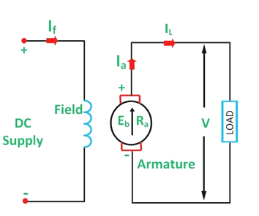
Diagram of Separately excited DC Generator

Slide 29
INPUTS USED:
Wind Speed (as RPM)
Considering Constant Tip Speed Ratio (λ)
Air Density (to be used)
Area Perpendicular to the flow of Wind (to be used)
Power Coefficient (to be used)
Pressure at Height of turbine(to be used)
Temperature(to be used)
Humidity(to be used)

Slide 30
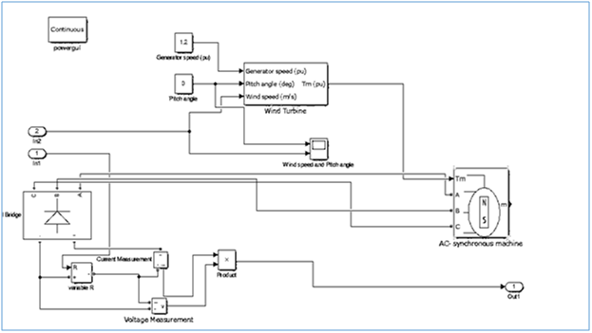
MATLAB SIMULATION:

Slide 31
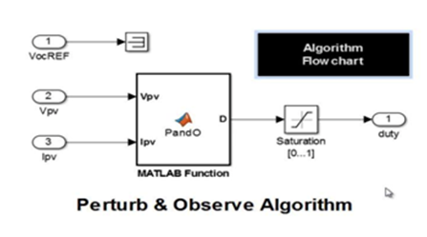
THE PERTURB AND OBSERVE ALGORITHM SIMULATION IN MATLAB

Slide 32
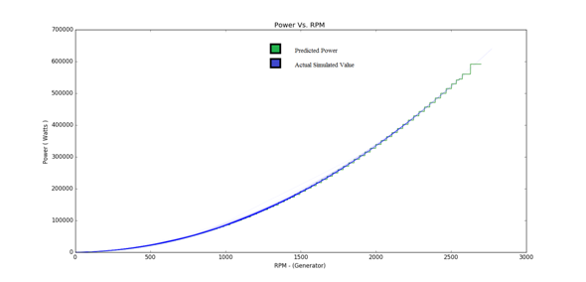
MPPT from simulation and ML
(Depicts the slight variation of ML values towards MPPT (actual))

Slide 33
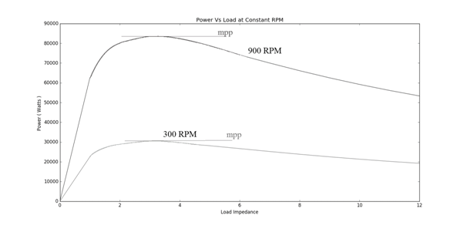
MPPT of two Power Vs. Impedance graphs at 300 and 900 RPM

Slide 34
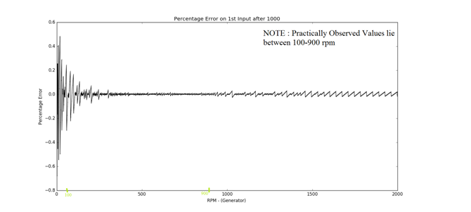
Error between the predicted and actual MPP:

Slide 35
Error Encountering and Tackling:
The graph mentioned the deviation from the actual value to the predicted value at different wind speeds, assuming (T+1) ^{th} Wind speed can a lie between in effect to (0 – 2000+) RPM of the generator. This additionally is just showing that the error comes to around less than a factor of 0.6% for the realisable conditions extrapolating linearly for the non-realisable regions.

Slide 36
STATISTICS:
Time taken for Calculating MPP from Predicted Load Impedances:
= ~ 0.313 / 2500 calculations
= ~ 0.0001252 seconds/per MPP calculation
which is realisable, compared to the amount of calculations it will be doing in real-time.

Slide 37
CONCLUSION

